Slide 1
CLAS 220 Introduction to Classical Mythology
Introduction to Epic Iliad 1-4

Slide 2
Quiz Question
Who is the chief hero of the Iliad?
Aeneas
Anchises
Achilles
Agamemnon

Slide 3
Quiz Question
2. Who is Chryseis?
Achilles’ sister
Agamemnon’s captive woman
Menelaus’ wife
Hector’s mother

Slide 4
Quiz Question
3. What is the name of Achilles’ mother?
Deidamia
Thyrsus
Demeter
Thetis

Slide 5
What is epic?
ἔπος, ἔπεα
epos, epea
(sg).word, speech
(pl.) poetry, epic poetry
Epic is poetry in a particular form (dactylic hexameter); usually about gods and heroes.
NB. Homeric Hymns are epic, and so are the Iliad and Odyssey

Slide 6
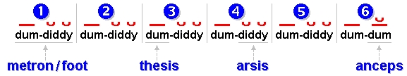
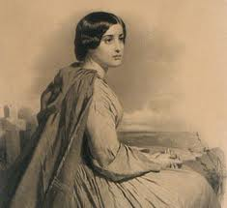
What is epic?
Epic metre: Dactylic hexameter:
English example:
“This is the forest primeval, the murmuring pines and the hemlocks.”
Henry Wadsworth Longfellow, Evangeline

Slide 7
What is epic?
Greek Example:
μῆνιν ἄειδε θεὰ Πηληϊάδεω Ἀχιλῆος οὐλομένην, ἣ μυρί᾽ Ἀχαιοῖς ἄλγε᾽ ἔθηκε, πολλὰς δ᾽ ἰφθίμους ψυχὰς Ἄϊδι προΐαψεν ἡρώων, αὐτοὺς δὲ ἑλώρια τεῦχε κύνεσσιν οἰωνοῖσί τε πᾶσι, Διὸς δ᾽ ἐτελείετο βουλή, ἐξ οὗ δὴ τὰ πρῶτα διαστήτην ἐρίσαντε Ἀτρεΐδης τε ἄναξ ἀνδρῶν καὶ δῖος Ἀχιλλεύς.
Iliad 1.1-7
Note: for a fuller performance of the opening of the poem, with an attempt to reproduce the sound of an original performance, see:
http://www.rhapsodes.fll.vt.edu/Iliad/iliad.htm

Slide 8
What is epic?
Content of Greek epic is the kleos of heroes
kleos is
fame
songs and stories about that fame (i.e. epic poetry)
worship as a hero

Slide 9
How is the story told?
Homeric Epic is originally oral
Beginnings of tradition unknown
By around 500 BC we know the text in its current form is being performed annually in Athens
How it arrived at that form is anyone’s guess:
Single poet wrote Iliad and Odyssey
Someone transcribed both poems from an oral poet
No one single poet; stories gradually evolved into current shape

Slide 10
How is the story told?
Many kinds of oral poetry around the world are built out of formulas, short building-blocks of language.
“Rosy-fingered Dawn”
“Swiftfooted Achilles”
“white-armed Hera”
By mixing and matching these kinds of phrases (built out of everyday speech), oral poets can compose poems of amazing length and complexity

Slide 11
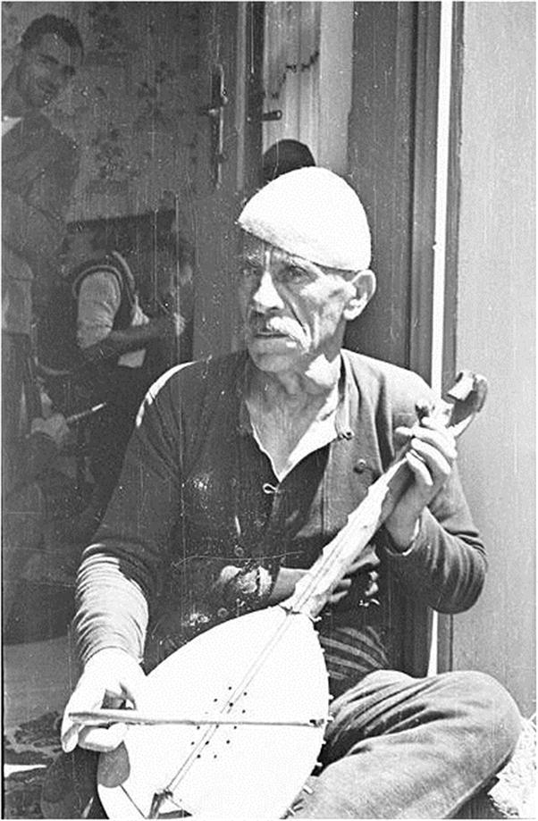
Avdo Mededovic (recorded 1935)
When the wedding-guests came to Raska
Alas, Sava inquired of Seremet:
“My brother-in-law, Seremetovic!
Who are the guests, from what border do they come?
In seven years such wedding-guests have not come hither
To fetch Sestokrilovic’s daughter Hankija!”
And Seremet spoke to Sava and said:
“Those are two imperial vezirs:
One, Sava, is from the city of Budim,
And the other is the pasha of Travnick:
They are both riding Al Otman’s horses.” When Sava heard Seremet,
Then Sava spoke to him and said: “Woe is me! O merciful God!
Had I known that they were imperial guests
With pashas and heroes of the border among them,
I would not have set out, nor come hither.
Nor would I….”

Slide 12
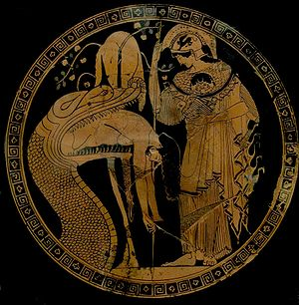
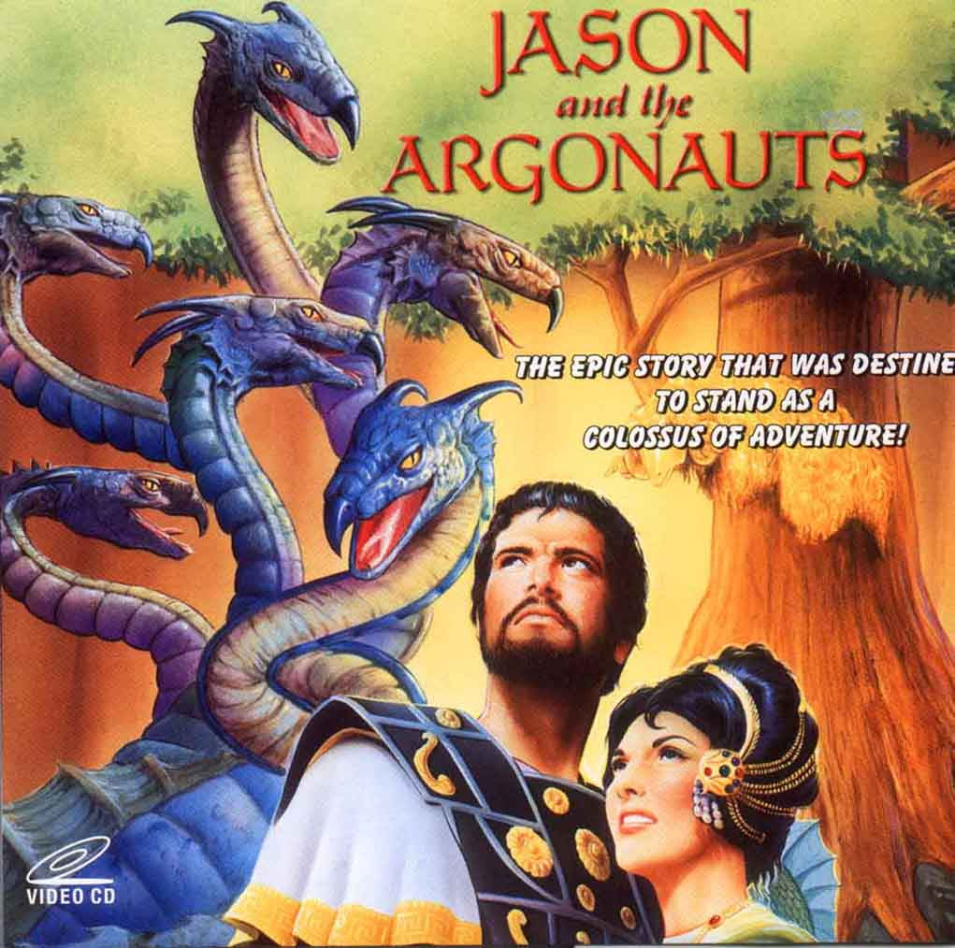
Epic Themes Jason and the Argonauts

Slide 13
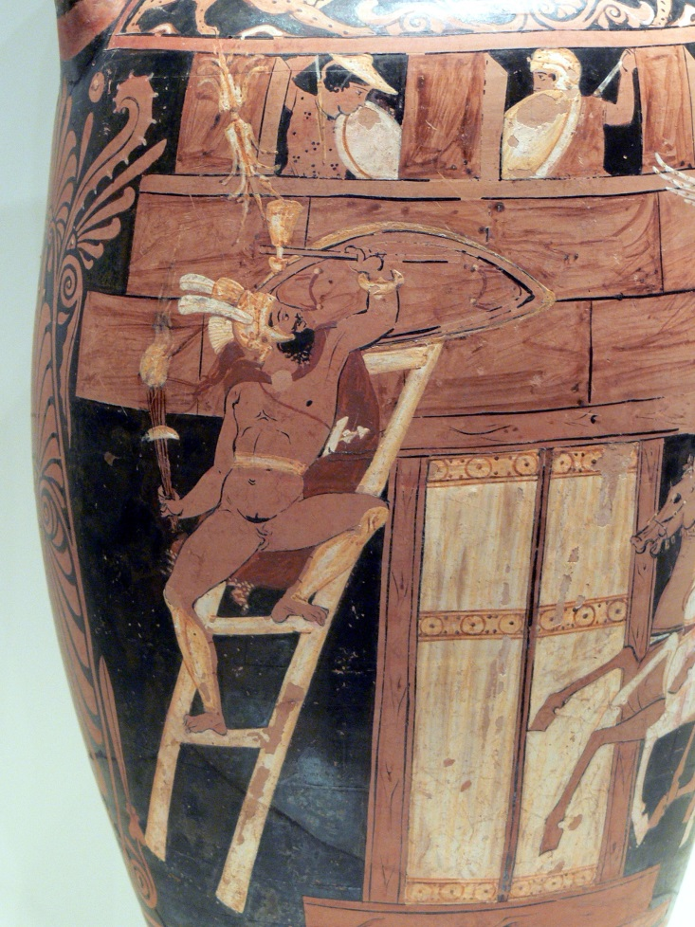
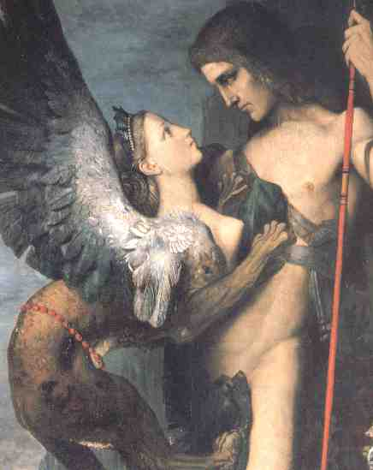
Epic Themes The Theban Cycle

Slide 14
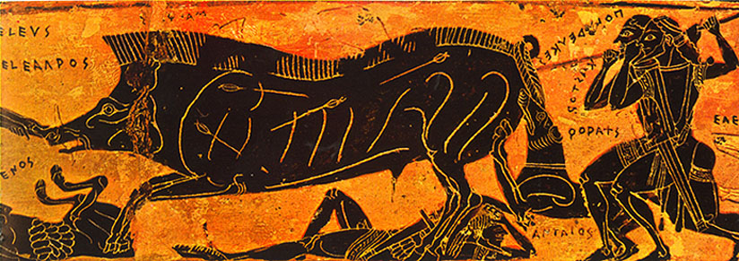
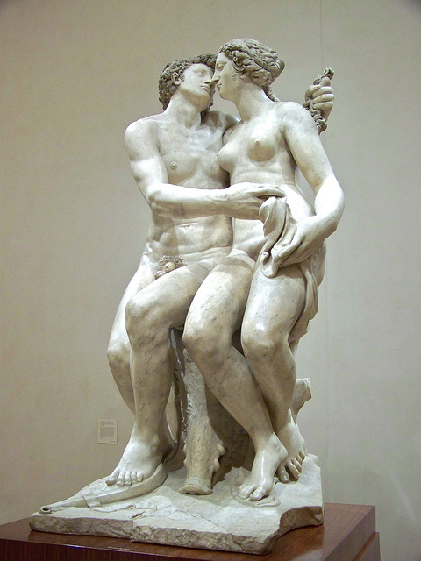
Epic Themes The Calydonian Boar Hunt

Slide 15
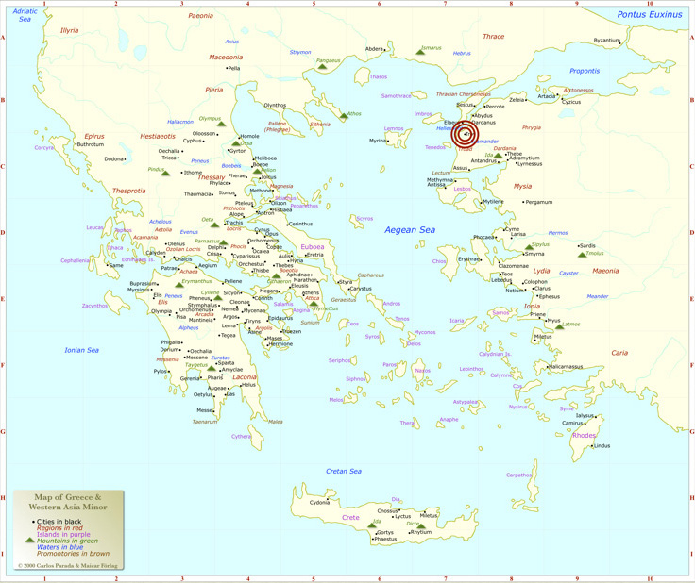
Epic Themes – The Trojan War

Slide 16
Epic Themes
Trojan War – the Epic Cycle
The Cypria
The Iliad
The Aethiopis
The Little Iliad
The Ilioupersis (The Sack of Troy)
The Nostoi (The Returns Home)
The Odyssey
The Telegonia

Slide 17
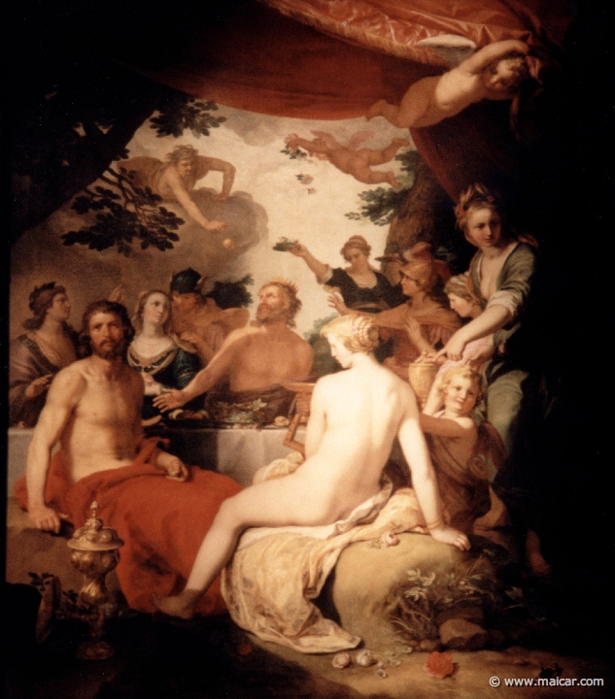
Cypria
Wedding of Peleus and Thetis

Slide 18
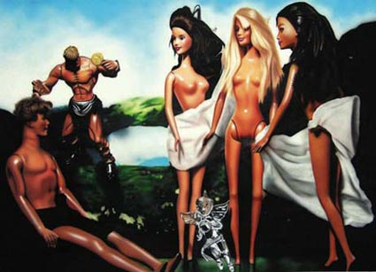
Cypria
Wedding of Peleus and Thetis
Judgment of Paris

Slide 19
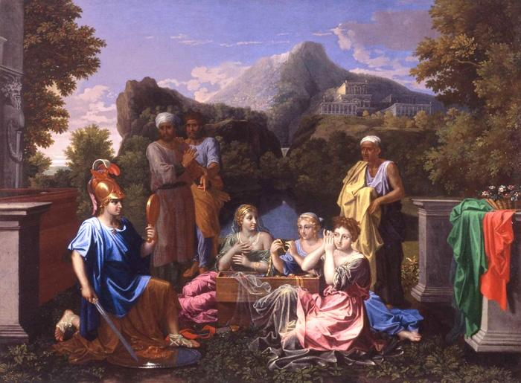
Cypria
Wedding of Peleus and Thetis
Judgement of Paris
Abduction of Helen
Gathering of heroes for battle
First nine years of the War

Slide 20
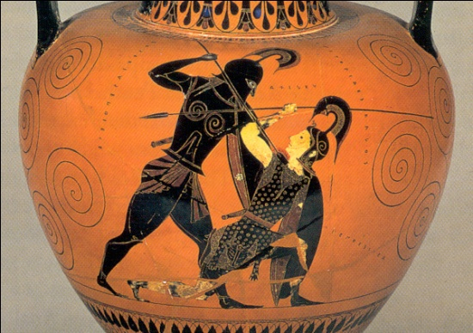
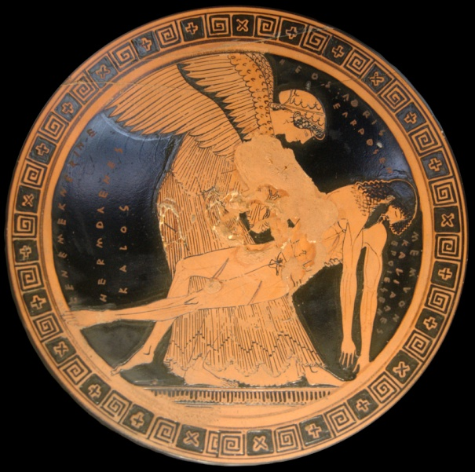
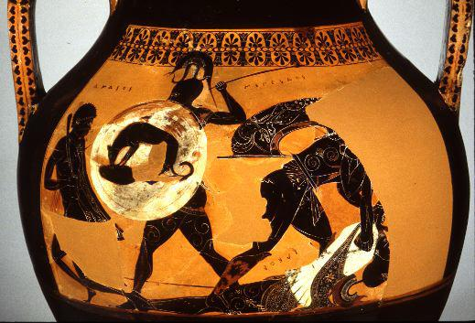
Aethiopis
Achilles defeats Penthisilea, the Amazon Queen
Achilles defeats Memnon, Ethiopian son of Eos the Dawn Goddess
Achilles killed by Paris with Apollo’s help

Slide 21
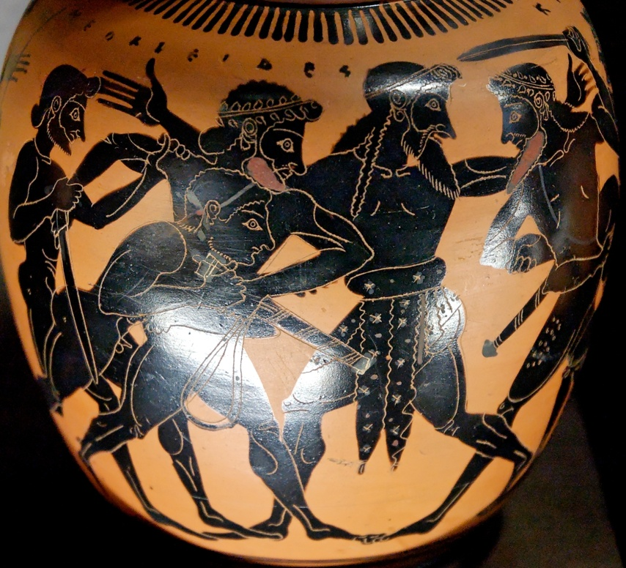
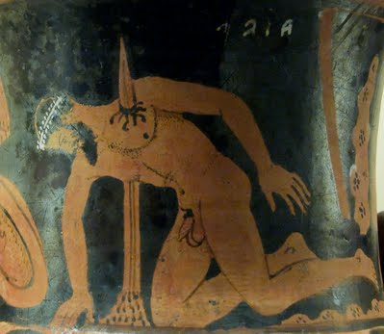
The Little Iliad
Ajax (strength) and Odysseus (cunning) fight for Achilles’ armour; Odysseus wins.
Ajax goes mad and commits suicide; Odysseus gives the armour to Achilles’ son Neoptolemos
The Trojan Horse is built

Slide 22
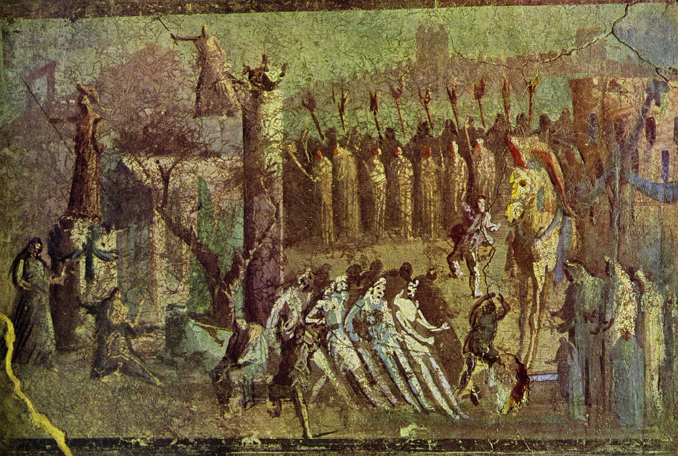
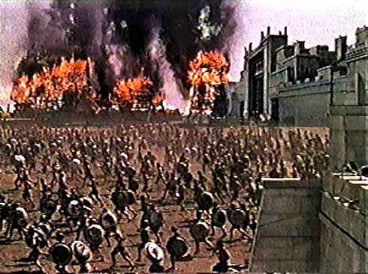
The Sack of Troy
The Trojans take the horse in
Troy is destroyed

Slide 23
What’s NOT in the Iliad
Judgment of Paris
Well over 90% of the war
The Death of Achilles
The Trojan Horse
The Fall of Troy

Slide 24
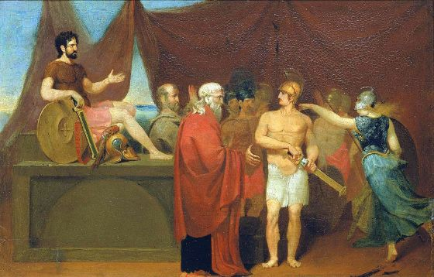
What IS in the Iliad
Anger be now your song, immortal one,
Akhilleus’ anger, doomed and ruinous,
That caused the Achaeans loss on bitter loss
And crowded brave souls into the undergloom
Leaving so many dead men – carrion
For dogs and birds; and the will of Zeus was done.
Begin it when the two men first contending
Broke with one another – the Lord Marshal
Agamemnon, Atreus’ son, and Prince Akhilleus
Iliad 1.1-7.
μῆνιν ἄειδε θεὰ Πηληϊάδεω Ἀχιλῆος οὐλομένην, ἣ μυρί᾽ Ἀχαιοῖς ἄλγε᾽ ἔθηκε, πολλὰς δ᾽ ἰφθίμους ψυχὰς Ἄϊδι προΐαψεν ἡρώων, αὐτοὺς δὲ ἑλώρια τεῦχε κύνεσσιν οἰωνοῖσί τε πᾶσι, Διὸς δ᾽ ἐτελείετο βουλή, ἐξ οὗ δὴ τὰ πρῶτα διαστήτην ἐρίσαντε Ἀτρεΐδης τε ἄναξ ἀνδρῶν καὶ δῖος Ἀχιλλεύς.

Slide 25
Quiz Question
4. Who fights in the first one-on-one combat in the Iliad?
Menelaus and Hector
Menelaus and Paris
Agamemnon and Achilles
Ajax and Hector

Slide 26
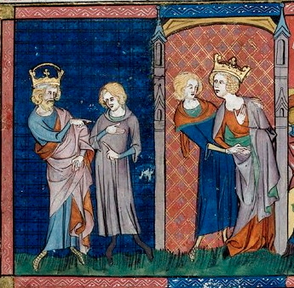
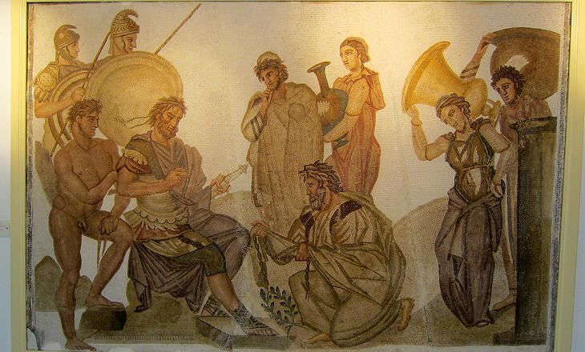
The Exchange of Women
Remember that the trigger for the Trojan War was Paris’ abduction of Helen (the unlawful exchange of women)
Iliad 1 opens with Apollo furious at Agamemnon for stealing Chryseis, the daughter of Chryses, a Trojan priest of Apollo
Agamemnon doesn’t want to return her, but does so under pressure
In revenge, he takes Achilles’ own captive woman, Briseis.

Slide 27
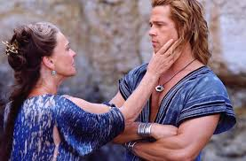
Achilles withdraws

Slide 28
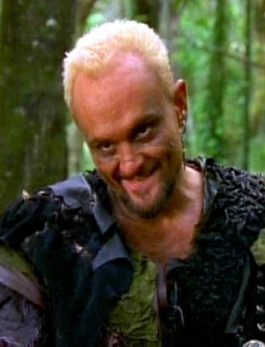
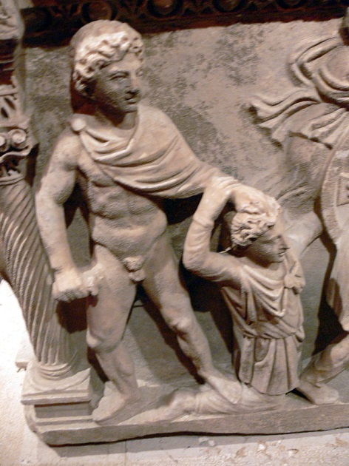
Doubts about war
So all subsided,
Except one man who still railed on alone –
Thersites, a blabbing soldier,
Who had an impudent way with officers,
Thinking himself amusing to the troops –
The most obnoxious rogue who went to Troy.
Bowlegged, with one limping leg, and shoulders
Rounded above the chest, he had a skull
Quite conical, and mangy fuzz like mold.
(Iliad 2. 244-251)

Slide 29
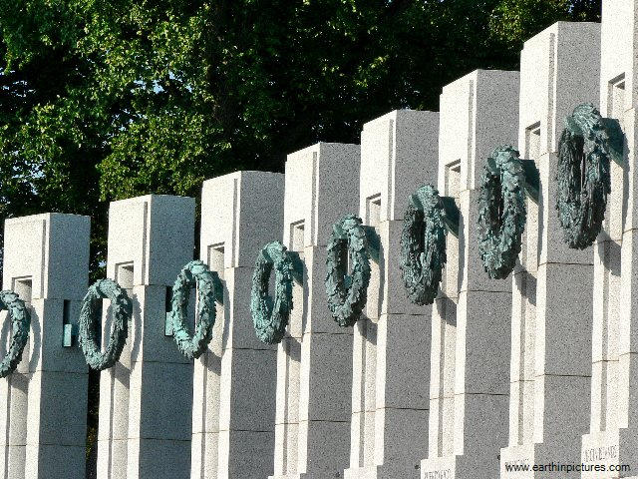
Catalogue of the Ships
Tell me now, Muses, dwelling on Olympus,
As you are heavenly, and are everywhere,
And everything is known to you – while we
Can only hear the tales and never know –
Who were the Danaan lords and officers?
The rank and file I shall not name; I could not,
If I were gifted with ten tongues and voices
Unfaltering, and a brazen heart within me,
Unless the Muses, daughters of Olympian
Zeus beyond the stormcloud, could recall
All those who sailed for the campaign at Troy.
Let me name only captains of contingents
And number all the ships.
Iliad 2.567-577
WWII Memorial, Washington DC

Slide 30
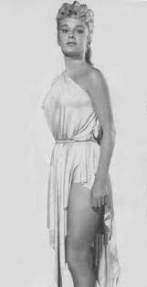
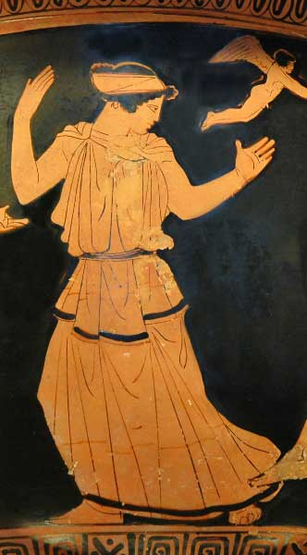
Helen on the Battlements
They sounded like cicadas in dry summer
That cling on leafy trees and send out voices
Rhythmic and long – so droned and murmured these
Old leaders of the Trojans on the tower,
And watching Helen as she climbed the stair
In undertones they said to one another:
“We cannot rage at her, it is no wonder
That Trojans and Akhaians under arms
Should for so long have borne the pains of war
For one like this.”
Iliad 3.180-189

Slide 31
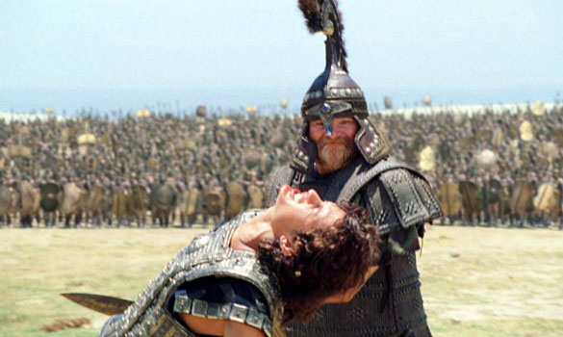
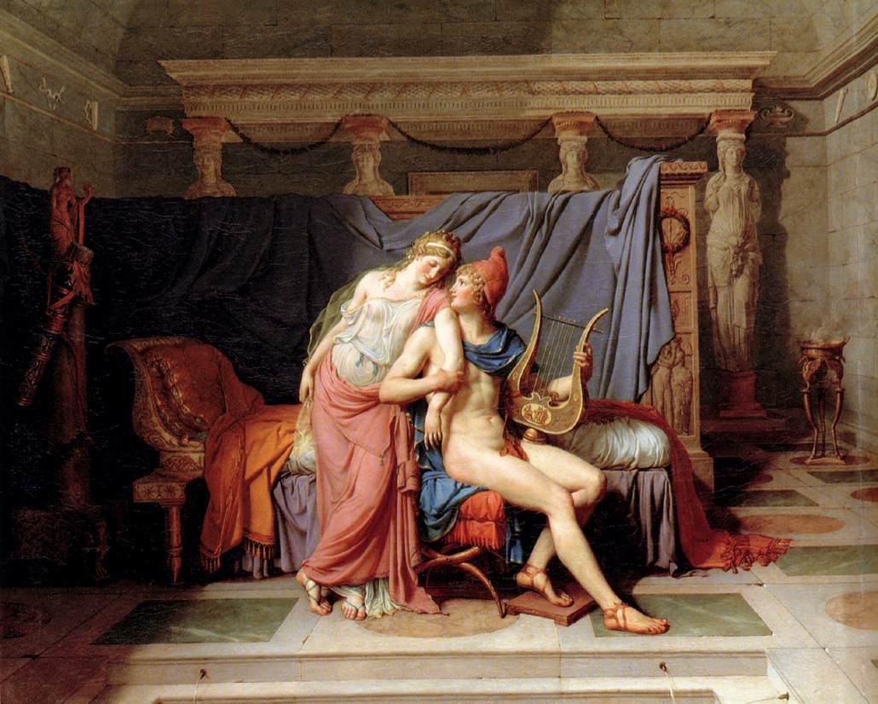
Paris Fights Menelaus
1. As it happens in Troy
2. As it happens in the Iliad

Slide 32
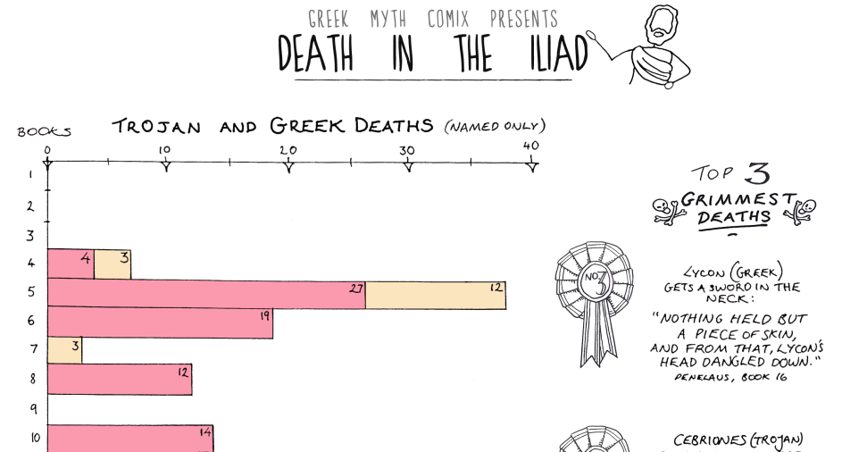
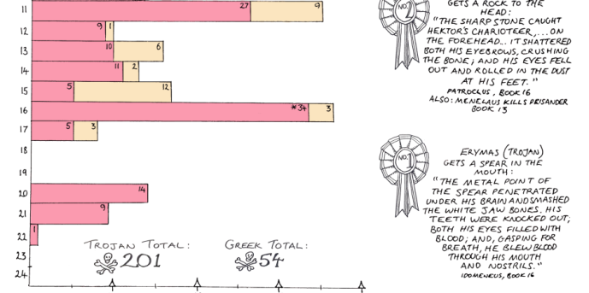
Book 4: Real Battle Begins

Slide 33
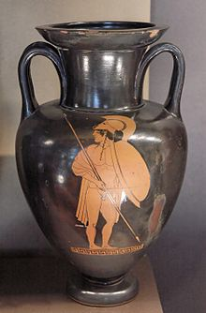
Book 4: Real Battle Begins
The First Death:
Antilokhos
Was the first man to down a Trojan soldier,
A brave man in the front line, Ekhepolos,
Thalysiades: he hit him on the ridge
That bore his crest, and driven in, the point
Went through his forehelm and his forehead bone,
And darkness veiled his eyes. In the melee
He toppled like a tower. (4.551-57)

Slide 34
Quiz Question
5. What is the name of the captive woman Agamemnon takes from Achilles?
Briseis
Thetis
Doris
Andromache

